Slide 1
Austin Study
Jessica McPhaul

Slide 2
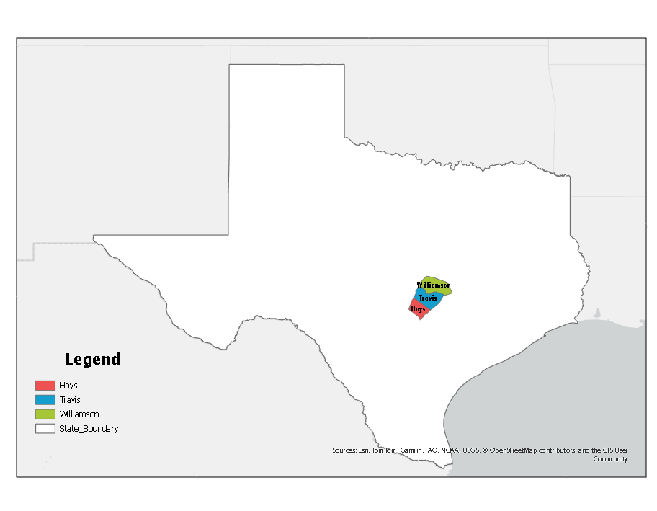
Austin Counties

Slide 3
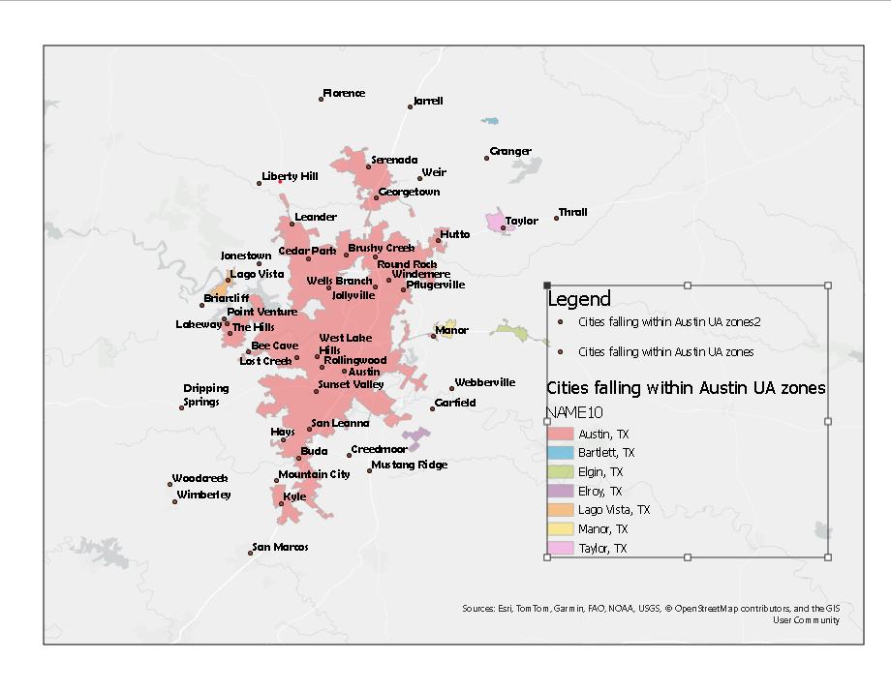

Slide 4
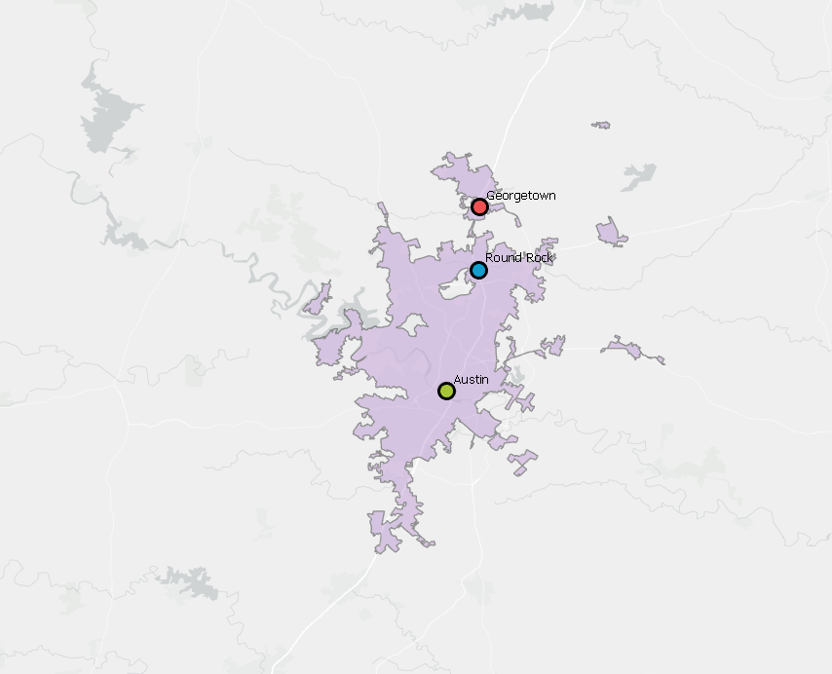
Most Populous

Slide 5
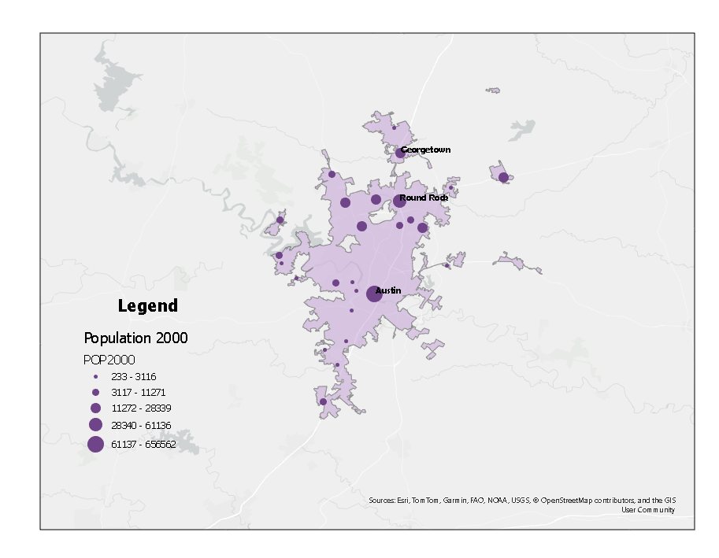

Slide 6
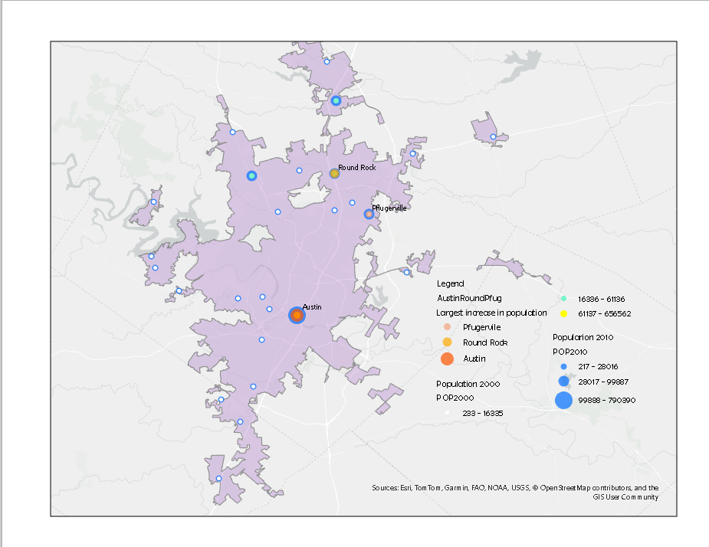
Biggest Increase in Population

Slide 7
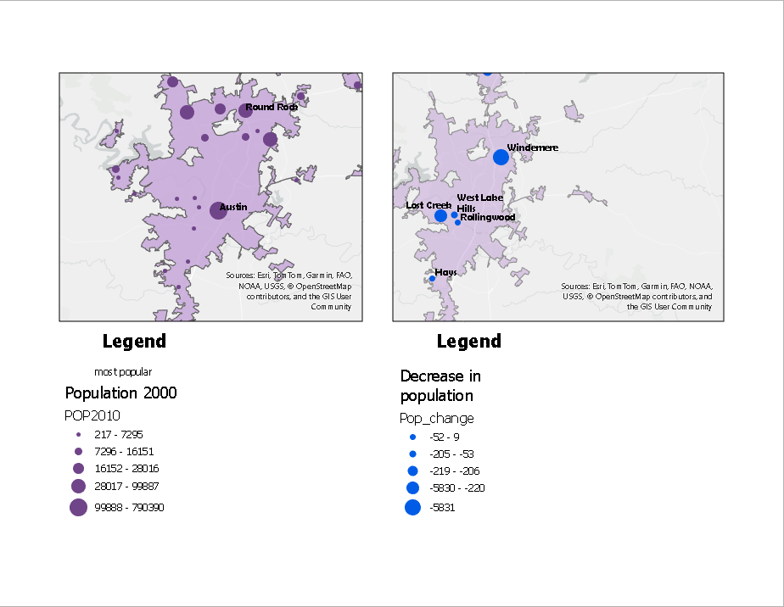
Largest Decrease in Population

Slide 8
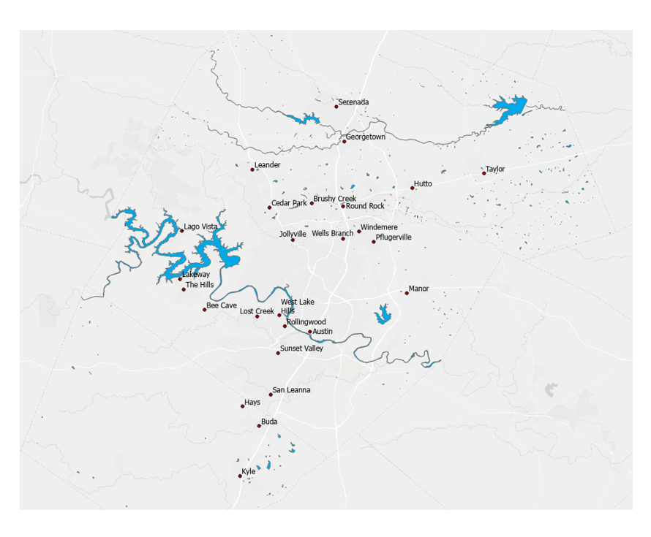
Waterways

Slide 9
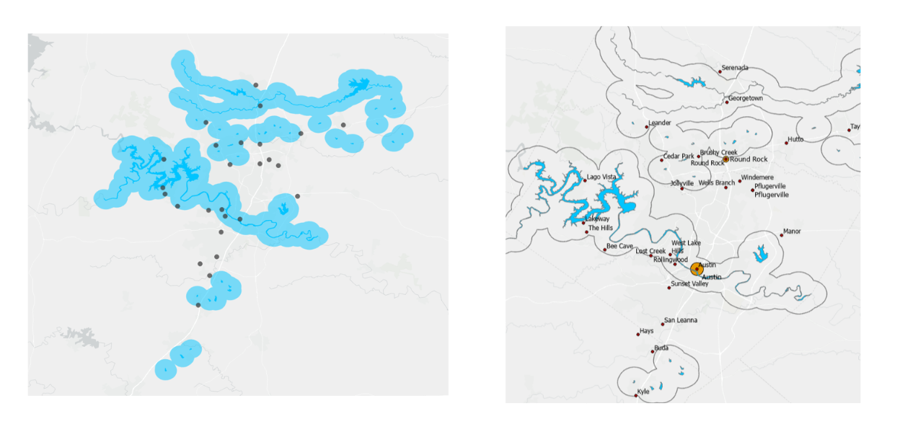
Buffer of 2 miles. Austin, Round Rock and Pflugerville are largest cities. Round Rock is within Buffer. Pflugervile is out of buffer. Water Proximity & Population: Mixed correlation observed. Areas outside buffer zone (Windemere, Serenada, Lost Creek) show population decline.
Centralized Growth: Strong growth within buffer zone (Austin) and at the edge (Round Rock).
Outlier: Pflugerville (outside buffer) contradicts water proximity theory.
Conclusion: Water proximity isn't the sole driver of population change; other factors at play.

Slide 10
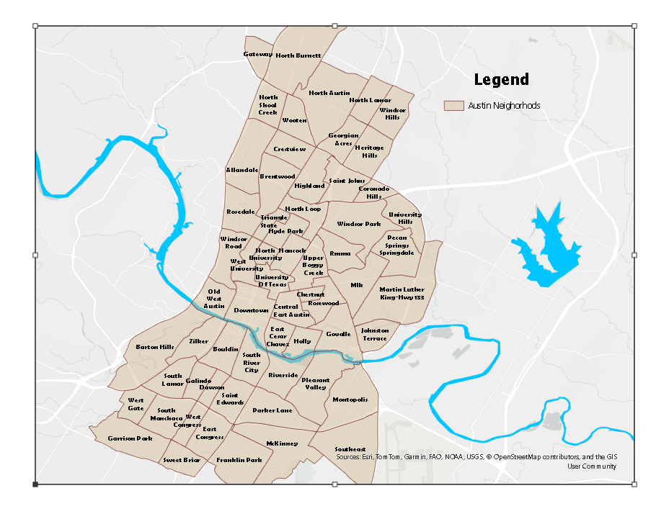
Austin with labeled neighborhoods

Slide 11
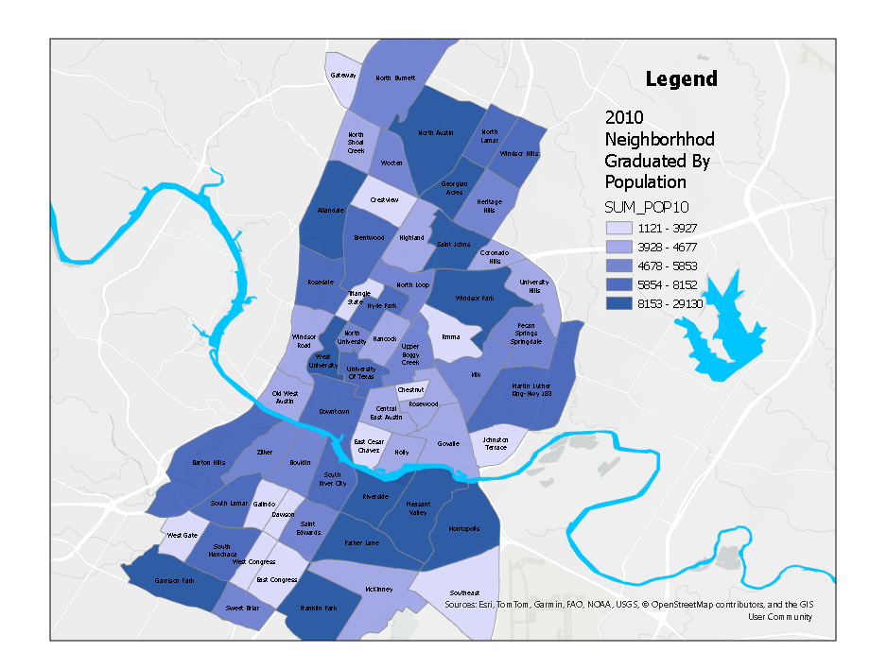
Neighborhoods by 2010 Population. SE of river is very populous. Near campus, near water and near downtown are are densely populated.

Slide 12
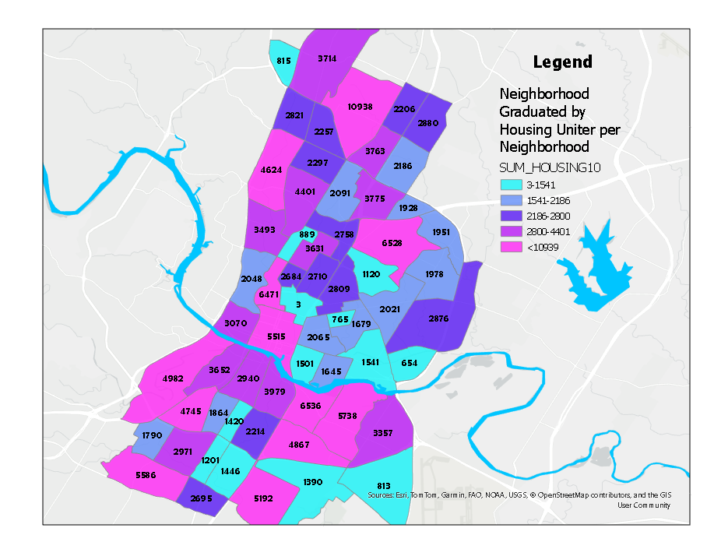
Neighborhoods Graduated by Housing Units Per Neighborhood

Slide 13
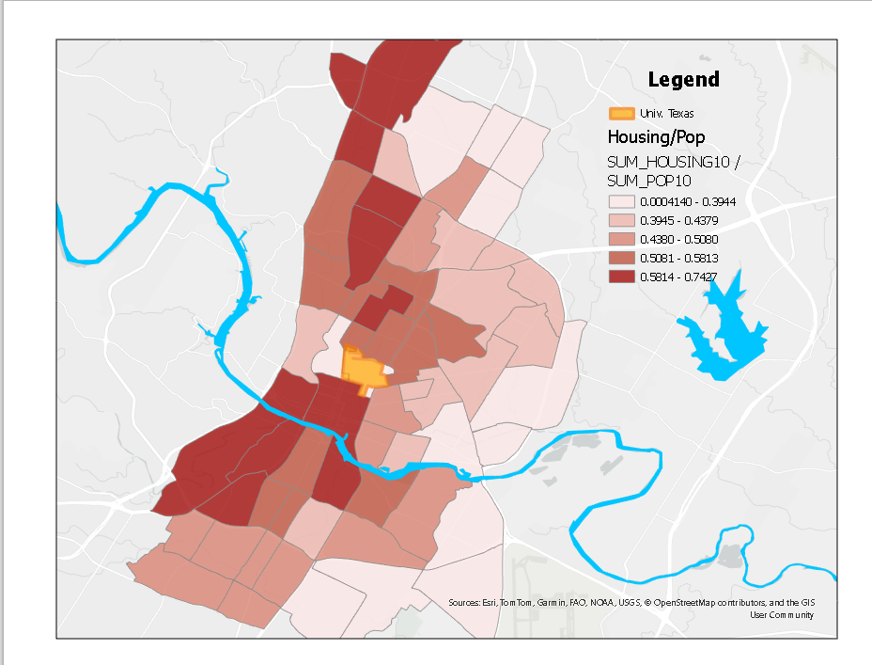
Location of UT is centralized with the city of Austin. This shows the concentration of population and housing close to campus.

